Slide 1

MOOCs: new wine in an old bottle?
Tita Beaven, Anna Comas-Quinn, Beatriz de los Arcos, Mirjam Hauck, Tim Lewis
Department of Languages
E-learning Symposium, 24-25 January 2013
Notes:
Are MOOCS, the OT12 on in particular, about old wine in new bottles or new wine in old bottles?
If it is old wine in new bottles this would imply a criticism: We are trying to fob you off with substandard stuff or stuff that doesn't work (old pedagogy!) by packaging it in a new, glossy way. We do the traditional first year undergraduate pedagogy (cognitive – behaviourist, we give you the content, you learn it and pass the exam), just that this time we hand it out to the masses and label it "innovation"!
New wine in old bottles, however, is slightly different:What we have done in the OT12 MOOC is not that dissimilar from the teaching approach we use at the OU (online delivery, forums, live sessions in Elluminate, etc. for large numbers of students, although we did not assess the participants; there was feedback though, through the comments and reflections of the participants).
But the wine, the content, what we were trying to do with the course - jointly explore an area in which we are not experts with a community of others who are also interested in the topic, that is open educational resources, open translation tools and open translation practices - is very different from what a "normal" OU module does (that is teach you what you need to pass the assessment).
That’s why we think OT12 is about new wine in sort of recycled bottles

Slide 2

Outline
What is a MOOC?
The Open Translation MOOC
Measuring success
(A)typical student
Learning in a MOOC
Conclusions and discussion

Slide 3
What is a MOOC?
A MOOC is a type of online course aimed at large-scale participation and open access via the web […] and a progression of the kind of open education ideals suggested by open educational resources. Though the design of and participation in a MOOC may be similar to college or university courses, MOOCs typically do not offer credits awarded to paying students at schools. However, assessment of learning may be done for certification. (Wikipedia)
An educational system should “provide all who want to learn with access to available resources at any time in their lives; empower all who want to share what they know to find those who want to learn it from them; and, finally furnish all who want to present an issue to the public with the opportunity to make their challenge known” (Illich, 1971)
Notes:
The term MOOC (Massive Open Online Course) comes from Canada. Dave Cormier and Bryan Alexander introduced the acronym to describe an open online course at the University of Manitoba which had been designed by George Siemens and Stephen Downes:
Connectivism and Connective Knowledge was presented to 25 fee-paying students on campus and 2,300 other students from the general public who took the online class free of charge
MOOCs = the educational buzzword of 2012 where definitions of what a MOOC actually is kept evolving.
This is the latest definition from Wikipedia (slide!)
The title itself reflects the aim of Siemens and Downes (not Cormier’s and Alexander’s, although they were also involved in the course) course, which was to follow Illich's idea that
an educational system should 'provide all who want to learn with access to available resources at any time in their lives; empower all who want to share what they know to find those who want to learn it from them; and, finally furnish all who want to present an issue to the public with the opportunity to make their challenge known'

Slide 4

MOOC =
http://www.youtube.com/watch?v=eW3gMGqcZQc&feature=player_embedded
(Cormier 2010)
Notes:
We propose Cormier’s conceptualisation of a MOOC as an event and would like to share this short clip with you where Cormier himself gives a brief introduction.

Slide 5

cMOOCs
Connectivism / the network
Knowledge creation and sense making happen in the network
Require high digital and learning skills
http://upload.wikimedia.org/wikipedia/commons/thumb/6/68/Canada_flag_halifax_9_-04.JPG/800px-Canada_flag_halifax_9_-04.JPG
Notes:
Canada, connectivism, aimed at those in the field of education, knowledge and sense making happen in the network, participants have high digital and learning skills

Slide 6
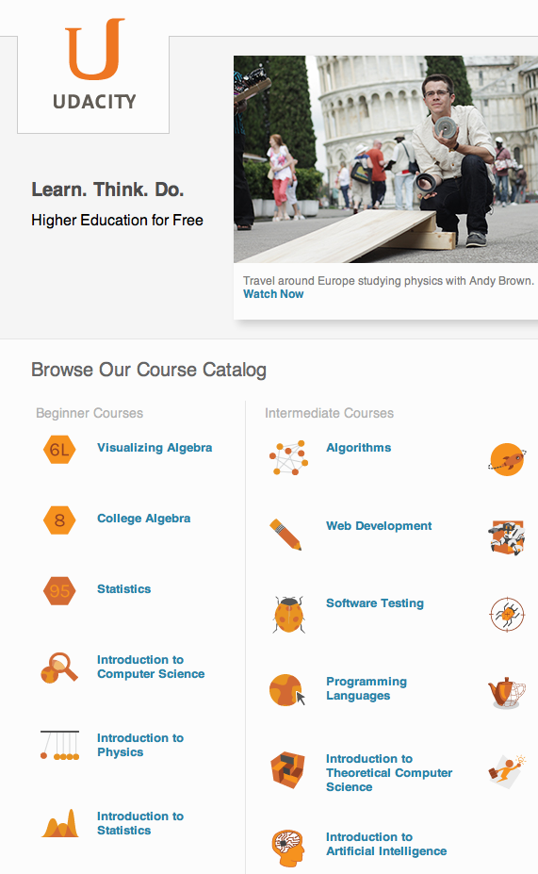



xMOOCs
Notes:
xMOOCs – US, traditional behaviourist-cognitive pedagogy (some social-constructivism), flipped classroom, undergraduate level, huge scale, accreditation, big players: EdX, Udacity, Coursera, FutureLearn?

Slide 7
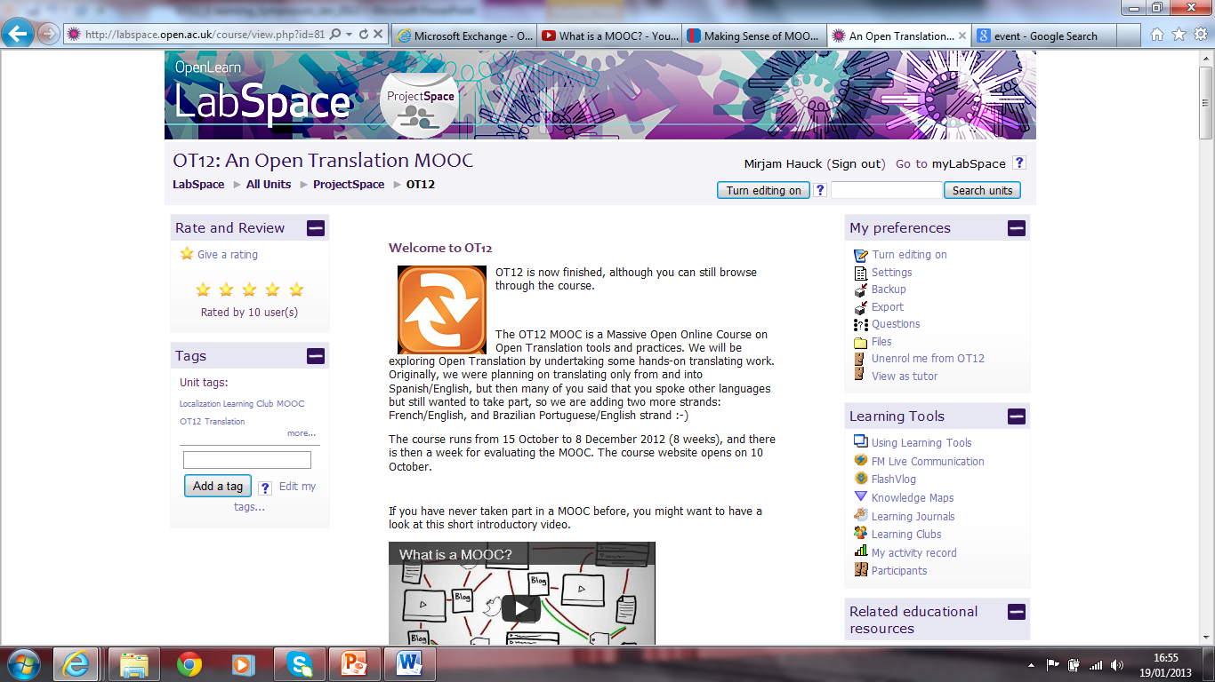
The OT12 MOOC
Notes:
Screen print of OT12
At the heart of MOOCs are the platforms that enable the various operations involved in offering a MOOC to be done effectively. Siemens (2011) says that 'MOOCs are really a platform‘.
The platforms for the two types of MOOC that Anna has described are substantially different because they serve different purposes. In Siemens' words a cMOOC model “emphasises creation, creativity, autonomy and social networking learning” whereas the xMOOC model emphasises a more traditional learning approach through video presentations, short quizzes and testing.
OT12 was probably a hybrid.
It was run in the so called LabSpace of Open Learn which is the part of OpenLearn that is a community-led environment built on the concept of sharing and reusing educational resources. It is intended for educational and professional practitioners and for more adventurous learners.

Slide 8

The OT12 MOOC
Open translation tools and practices
8 weeks + 1 week evaluation
Weekly activities:
    This week you'll have a chance to familiarise yourself with issues related to captioning and subtitling videos, and do some hands-on practice using the open tool Amara (Universal Subtitles) …..
    This week we will talk about translating OER, and you'll start using Transifex, a translation workflow and crowdsourcing platform …
Notes:
Open Translation practices rely on crowd sourcing, and are used for translating open resources such as TED talks and Wikipedia articles. They are also used in global blogging and citizen media projects such as Global Voices.
There are many tools to help Open Translation practices, from Google translation tools to online dictionaries like Wordreference, or translation workflow tools like Transifex.
The main purpose of the MOOC was to explore some of these tools and practices.

Slide 9
The OT12 MOOC
background reading/clips to watch
forum(s) to engage with
subtitling and translation work (OERs)
wiki on quality assurance for OT projects
webcast seminars in Elluminate with guest speakers
blog
weekly digests
Notes:
Background reading and/or introductory clips to watch and at least one forum to engage with. Forum work evolved around themes such as in week 5 a forum dedicated to issues associated with the use of Transifex, the translation workflow tool we were experimenting with for the translation of
An OER on Translation Theory and
- Learning to Learn, an Open Educational Resource from the Open University for the Bridge to Success project (which was a secondary aim of running the MOOC).
["Learning to Learn“ teaches basic study skills to adult students returning to education. It is part of the Bridge to Success (B2S) project, a US-based project funded by the Bill and Melinda Gates Foundation and the William and Flora Hewlett Foundation to encourage student retention and progression in college, especially amongst disadvantaged students or those that have little previous experience of education at this level.
The team behind the "Learning to Learn" resources were keen to have the materials translated into Spanish to encourage learners from the large Hispanic community in the US to take up and stay in further or higher education.]
The first guest speaker from the Open Translation community was Jules Rincon, from Amara (Community Support and Advocacy). He also moderated a forum for questions about Amara and the participants’ experience of captioning and subtitling.

Slide 10

OT12 – some stats
600 showed and interest/received the digests
292 registration
44,138 page views (27,687 unique) during 8 weeks of MOOC action
9,138 views WELCOME FORUM
411 views GOODBYE FORUM
  → a TOOC or a NOOC ☺
Notes:
Bea = this was a very small MOOC in terms of registration but don’t forget that the weekly digests went to a mailing list of roughly 600 people.
The page views correspond to the 8 weeks of MOOC action; I added the views for the welcome and goodbye forums as a way to show the downward curve but maybe you want to take it out?, the most views were for the WELCOME Forum, followed by AMARA, TRANSIFEX, CAPTIONS and SUBTITLES, and DICTIONARIES FORUM = when participants were asked to do something rather than just contribute an opinion or a reflection, if you know what I mean (?).
Balch (2013) about MOOC completion rates and the importance of student self-investment:
"Most MOOC students are simply adding the MOOC to their existing lifestyle. They’re not moving [to a dorm], they’re not paying a significant fee. [...] All a student need do is provide an email address, and click a button labelled “sign me up.” [...] Enrolling in a MOOC costs nothing [...] Failing a MOOC costs nothing. [...] There’s not a lot of data yet, but my hypothesis is that students are significantly more likely to enrol in an interesting MOOC than in a comparable course at a university. And importantly they are also substantially more likely to withdraw. This combination of factors points to a low completion rate for MOOCs. [...] the more investment we see from the students, the higher the completion rate. Overall I suggest that the definition of “enrolled” for a MOOC should probably not include those who simply click “sign me up.” Those who took a quiz are at least a bit invested, those who completed a project even more so.
[OT12: higher level of investment from those who actually translated content]

Slide 11
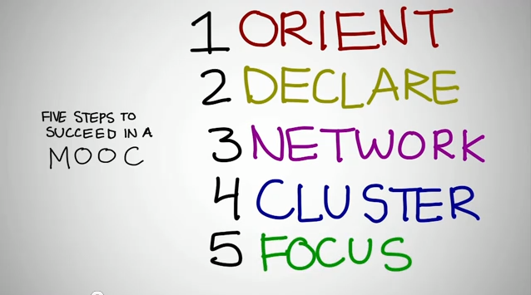
What is success in a MOOC?
  Cormier (2010):
Notes:
Success in a MOOC according to Cormier’s (2010) 5 stages:
Orient
Where are the materials, the links I need to use every week, the times of the live sessions (gather these together/bookmark them!)?
In some ways a MOOC is just like being on the Web … with one big exception: a MOOC is paced!
The materials are there and the more you cover the more you can participate
[make link to participatory literacy skills as understood by Pegrum (2009) that is the ability to contribute to blogs, wikis, social networking and sharing sites, virtual worlds (VWs) and gaming environments]
2. Declare yourself
You need to have a place for your thoughts and your reflections to live. This might be a blog you write. It might be a discussion forum that’s part of the course … some way of gathering the participants’ reflections (you already have a blog, you write a reaction to one of the readings, add a post tag to it and send it to Twitter).
And then ... probably nothing happens! No one grades it, no one comments. → You need a network!
continued on next slide …

Slide 12
Julia’s story - networking
Hi Sofia,
I’m assuming you're Brazilian. I normally work Portuguese-English but for this exercise obviously have to work into Portuguese. But I'm not 100% sure of grammar. Would you be able to edit what I've done? Agradeço a sua ajuda!
  Hi Julia,
  Yes, I'm Brazilian. I am more than willing to revise your work, just not sure yet how to do it in the Transifex website. I'll take a look and get back at you!
  Good to be in contact!
Obrigada Sofia,
Eu também vou ver se consigo ver como editar. Se descobrir como depois digo alguma coisa.
Notes:
3. Network
You need to follow some other people reflecting on the material and make some connections. You can go back and look at the communications you’ve been getting from the facilitators, read a few posts and comment on them.
The connections and the comments is what the course is all about!
Go back to your spot (your blog, for example) and write a thoughtful reply to someone’s questions or concerns. Tell them that you have done this … make connections! There is/will be a discussion going on.
A discussion is what you took the course for!
After a few weeks, it is probably time to …
4. Cluster
During the first weeks of reading and commenting you are likely to realise that there are a few other people whose interest in the MOOC (certain parts of it) is very close to yours.
You are returning to their work more often and that they are commenting on your work more often → you are connecting!
You don’t need to connect with everyone. Find yourself a cluster of people who are focussed on what you are interested in! A group of people for you to work with. Maybe even a community that might share ideas even after the course is over.
[“The success of our first course - CCK08 – was not anticipated. We found quickly that the course took a life of its own as participants created Second Life meeting areas, Google groups to discuss certain topic areas, study groups for people in similar locations, Facebook groups, and so on.” ( McAuley, Stewart, Siemens and Cormier 2010)]
5. Focus
Even with all the positive connections and the interesting readings and all the learning, you will find that a little over half way through the course your mind starts to wander. You are not sure what you are trying to do with the course: If you are not trying to finish the course for credit, why are you trying to do it?
You can draw on your new cluster to help you with your plans, start a project, maybe a paper, maybe a grant application and use the rest of the course to finish it.

Slide 13
Julia’s story – clustering/focusing
Hi everyone on the Portuguese team,
I worked on two sections of the Portuguese translation. I have just gone in now and am so happy to see that we have finished the translation! Well done everyone!
  I see, however, that it hasn't been reviewed. Here is where I will state my limitations. My Portuguese suffers from not knowing whether it's European/Brazilian given my exposure to both influences, so I'm the wrong person to review this translation.
  Ideally only one person should review the translation so that he/she can pick out the inconsistencies in terminology and style. Is there anyone who can volunteer to do this final necessary step of our project? [Julia]
Hello everyone,
I am happy to help with the revision. How do we mark strings as revised?
I have just had a look and found there are still some English strings marked as translated but they just have the source code.
I have made some suggestions to some translations and before I realised there was a tool for it, I had changed a few strings. Would you guys prefer see suggestions or just see the revised string? How do we make sure suggestions are reviewed and implemented? Will there be notifications if anybody suggest a review?
I have left a question about how to deal with the html code - I see this is missing in so many strings that I am confused about how to handle it. Hugs, Paula (Global Voices)
Notes:
Cormier’s is very much confined to the elite, education MOOCs of the connectivist type; all stages might not be necessary for every type of MOOC or every type of student, and they might take different forms or even take place off-line

Slide 14
What is a successful MOOC?
For the institution / the organisers
  Statistics: registrations, completion and pass rate
For the individual
  Student investment
  Visible and invisible participation
Notes:
Success for the individual might be very different to success for the organisers. The example from Bulgaria in Balch.
Challenges of the traditional measures for a MOOC: Concept of learning; engagement is uneven; drop-out rate; assessment; accreditation
You cannot measure it like this because the student investment for registration is so low that participation will look different from traditional courses

Slide 15
Learning and MOOCs
MOOC as an event around which the network can be created
  I am here alone in my desktop, but I'm writing and reading ideas, values, projects... feeling connected!
Level of participation (Lave and Wenger, peripheral participation and apprenticeship to the community of practice)
  sometimes I felt outside of the group not because of the group itself but because I haven't got much experience about translation to share
  It was great to see that some of the answers to my questions came from the other participants, and not necessarily from the facilitators.

Slide 16
Learning and MOOCs
Learning as process not content (move from acquisition metaphor)
Active participation can appear passive (the observer / the autodidact)
The outcome may not be an assessable artifact but still be important to the learner
  I took the chance to get myself in as a translator at one ONG.
  I watched the online seminar about translation quality which helped me with my dissertation topic!
  Our university professor asked us to work on the project in groups of 3. So each of the three students chose to do part of each week's tasks. I did not choose to use Amara because I was already familiar with it since I am a TED translator.
Notes:
We are used to assessing something so find it difficult to talk about learning when there is nothing to show for it (nothing that we see)
However, there may be very real examples of evidence of learning for the learners themselves (examples from the end survey)

Slide 17
However ….
  Hi … I watched all the videos but did not complete the final exam nor I submitted any of the intermediate assignments. However I am deeply engaged and I made all the analysis (SR, event study etc.) for the local stock exchange in my country (Bulgaria). I am also seriously considering extending knowledge in this area (e.g. first I would read any of the books you mentioned. Do you have any better proposal?). Shortly said statistic would probably classify me as attendee who only clicked “sign up” and then forget about the course but it is not the case definitely. Just balance between professional duties, kids at home and this stuff prevented me from being more active … My point is that there could be many who do not appear engaged in the course but are quite much in fact and this should be taken into account.
  (a learner in ‘Computational Investment Part I’, see Balch, 2013)
Notes:
Cormier’s is very much confined to the elite, education MOOCs of the connectivist type; all stages might not be necessary for every type of MOOC or every type of student, and they might take different forms or even take place off-line

Slide 18
Conclusions
New/old wine in a new/old bottle?
Need for self-motivation
Need for participatory literacy skills
Success measured in different ways
Interest in a different kind of reward
MOOCs don't change the nature of the game; they're playing a different game entirely.
(Downes 2012)
Notes:
New/old wine in a new/old bottle:
More “learning in the glass” than has been acknowledged so far (i.e. learning happening one learner at a time)
Knowledge creation and sharing and sense making takes place in the network and the community, but ultimately the learning that each individual derives from the experience is personal and unique, depending on their circumstances, previous experience, level of engagement, etc.
On motivation:
If we look at MOOCs like we look at traditional courses (both on- and offline) our default assumption is likely to be that students are unmotivated.
But: The big difference between a MOOC and a traditional course is that joining a MOOC is completely voluntary. You decide that you want to participate and you decide how to participate (see example of Bulgarian student in Balch’s MOOC).
That’s why Downes (2012) says “If you're not motivated, then you're not in the MOOC.”
This also explains researchers’ renewed interest in “heutagogy” when trying to explain what it is that is actually happening in a MOOC.
“In a heutagogical approach to teaching and learning, learners are highly autonomous and self-determined and emphasis is placed on development of learner capacity and capability with the goal of producing learners who are well-prepared for the complexities of today’s workplace.”

Slide 19
References
Balch, T. (2013) About MOOC Completion Rates: The Importance of Student Investment http://augmentedtrader.wordpress.com/2013/01/06/about-mooc-completion-rates-the-importance-of-investment/
Cormier, D. (2010) Success in a MOOC http://www.youtube.com/watch?v=r8avYQ5ZqM0&feature=youtu.be
Cormier, D. (2010) What is a MOOC? http://www.youtube.com/watch?v=eW3gMGqcZQc&feature=player_embedded
Daniel, J. (2012) Making Sense of MOOCs: Musings in a Maze of Myth, Paradox and Possibility http://jime.open.ac.uk/article/2012-18/html
Downes, S. (2012) What a MOOC Does - #Change11 http://halfanhour.blogspot.co.uk/2012/03/what-mooc-does-change11.html
Notes:
continued from previous slide …
On participatory literacy skills:
What they really needed were the skills and techniques that would ensure that a network of peers provided the comment and correction they aspired to. This links to Cormier's stages 2 & 3. → the need for participatory literacy skills for "success in a MOOC" (as opposed to "a successful MOOC"). The more I think about it the more I am convinced that a MOOC is NOT an event/environment, etc. where you will easily develop those skills, they are rather a pre-condition for your success in a MOOC.
Downes (2012):
“By starting out with a presumption of a different set of skills, MOOCs explicitly foster and value these skills.”
They do not necessarily help participants to develop these skills from scratch though!
Downes (2012):
What we are trying to do with a MOOC is to create an environment where people who are more advanced reasoners, thinkers, motivators, arguers, and educators can practice their skills in a public way by interacting with each other. In such an environment, people can learn by watching and joining in. This is not an 'assumption' that this happens; it is an observation.
If we can get past the idea that the purpose of a MOOC is to 'teach people stuff' then we can begin to talk about what benefits they bring. But so long as we just think of them as another way of doing the same old thing, we'll be misunderstanding them.

Slide 20
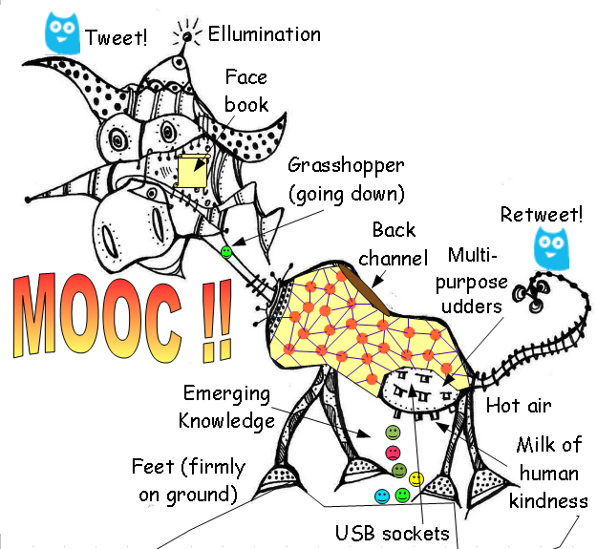
Thank you for listening!
http://gbl55.wordpress.com/2011/03/08/cck11-man-this-mooc-is-something-else/
inspired by José Bogado: la vaca de los sinvaca

